Slide 1

New Movie deals

Slide 2
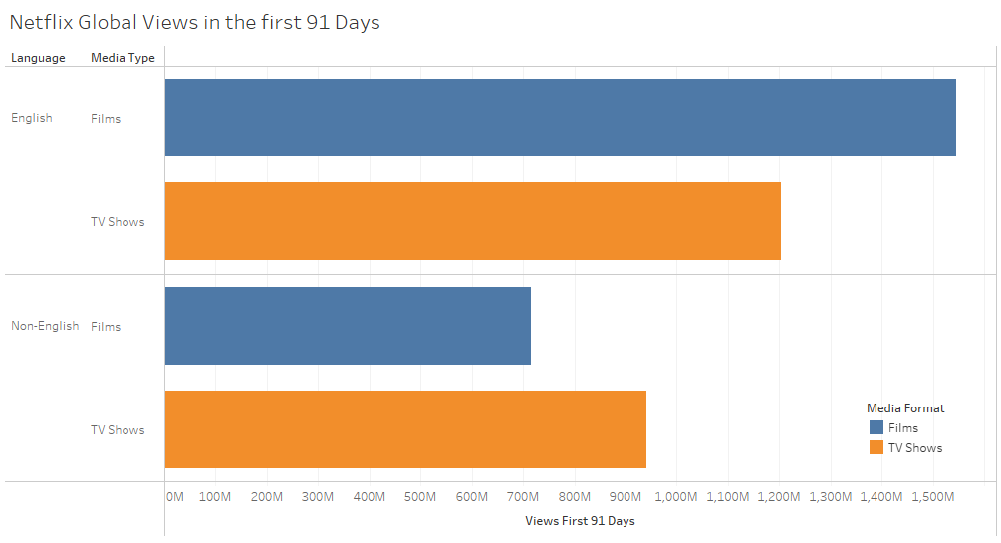
Views of new media
Focus on acquiring the rites to English Films

Slide 3
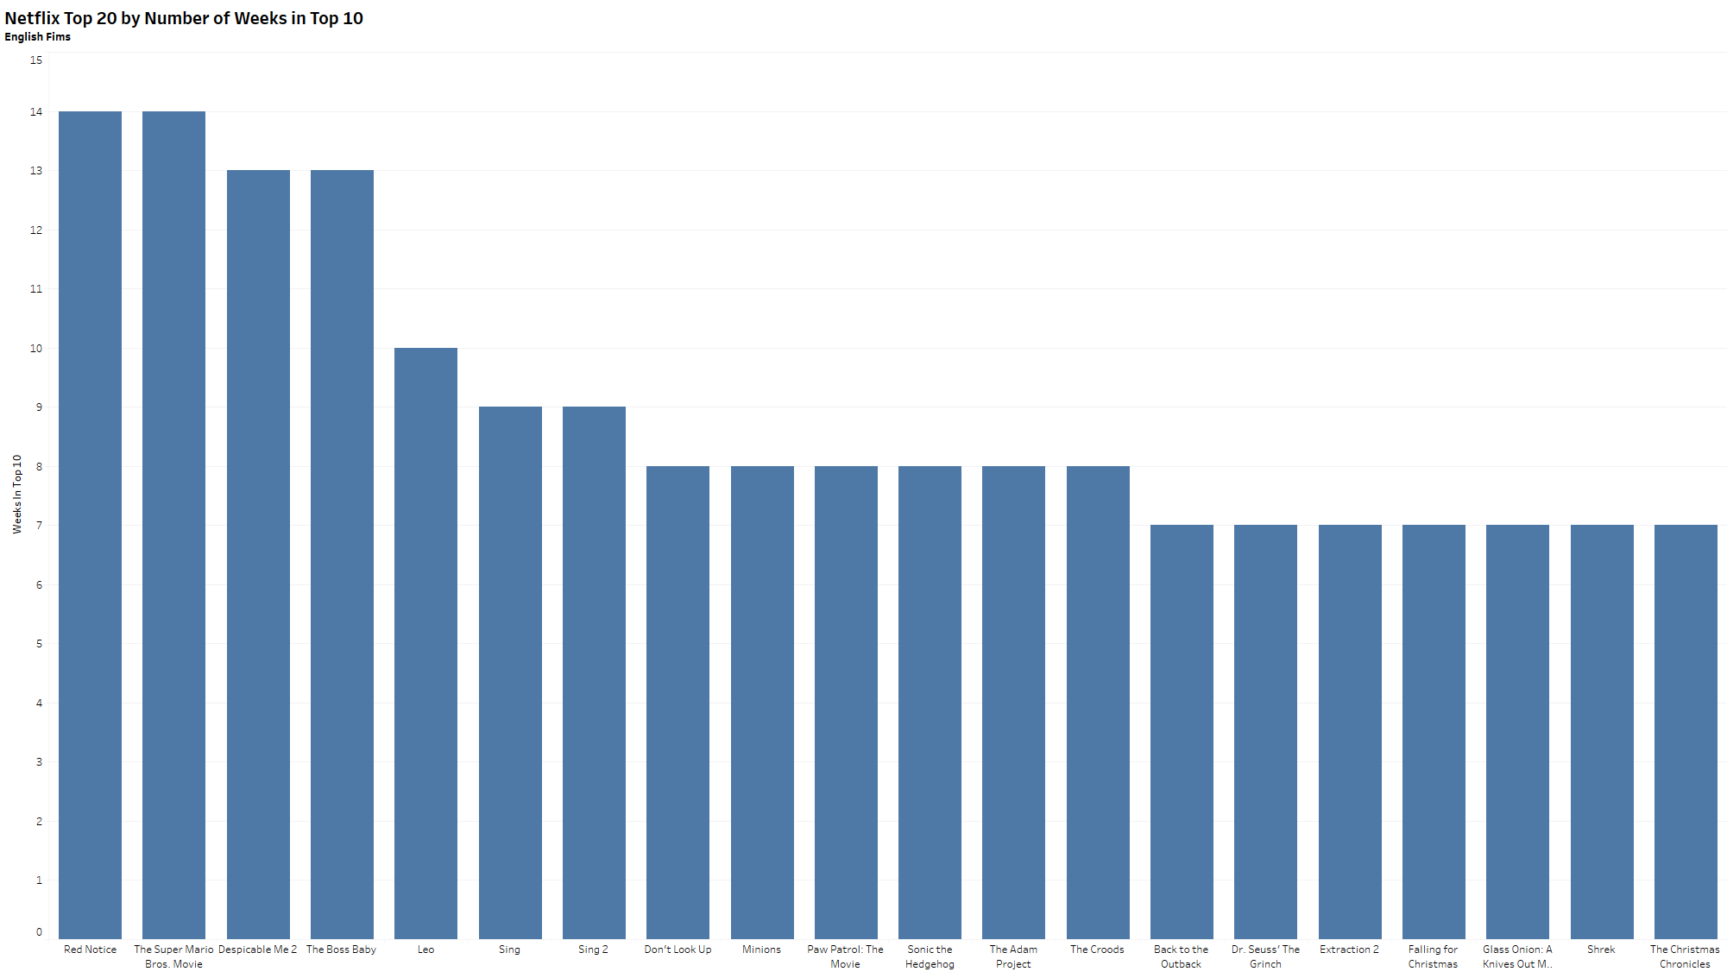
Top films by weeks in top 10
Work on acquiring movies similar to Red Notice, The Super Mario Brothers Movie, and Despicable Me 2

Slide 4
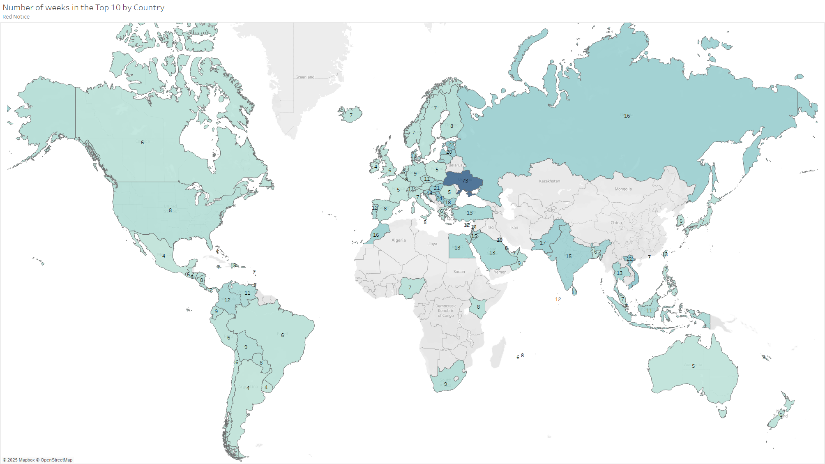
Red Notice weeks in top 10
Red Notice was distributed across our region and has driven it to the number one spot.

Slide 5
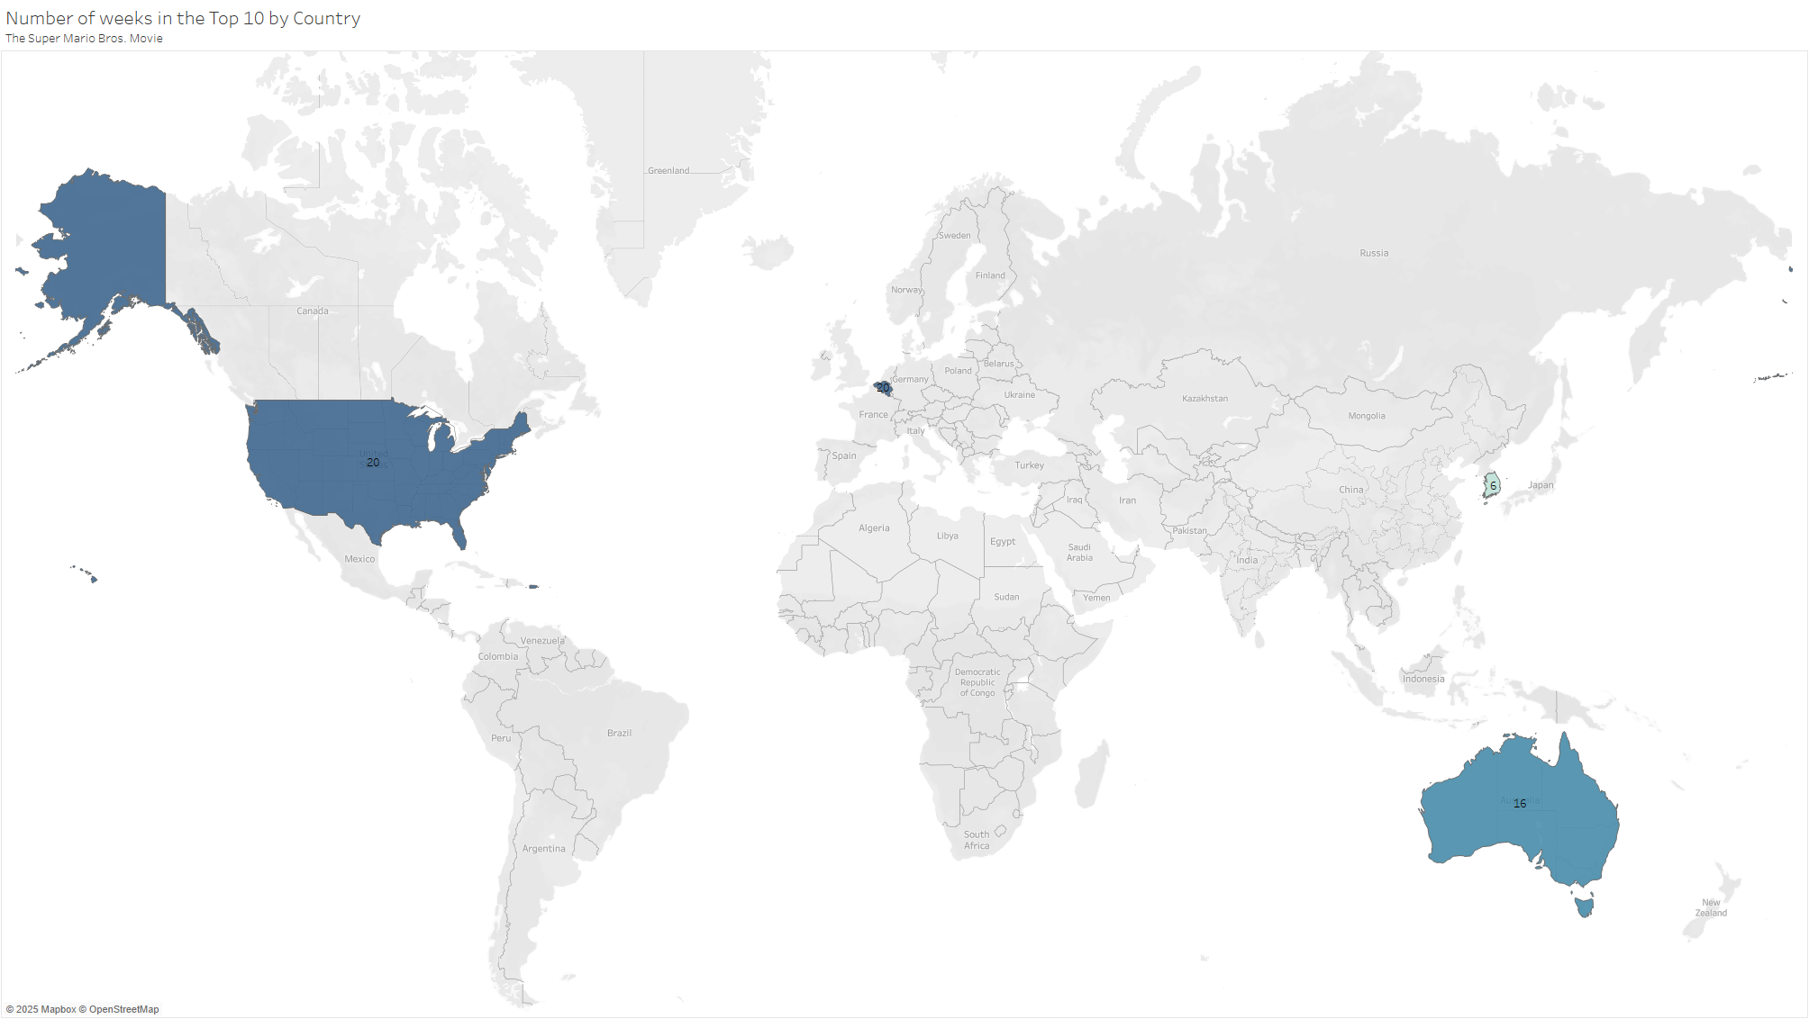
The Super Mario Bros. weeks in top 10
Mario Brothers was very popular in both the US and Australia

Slide 6
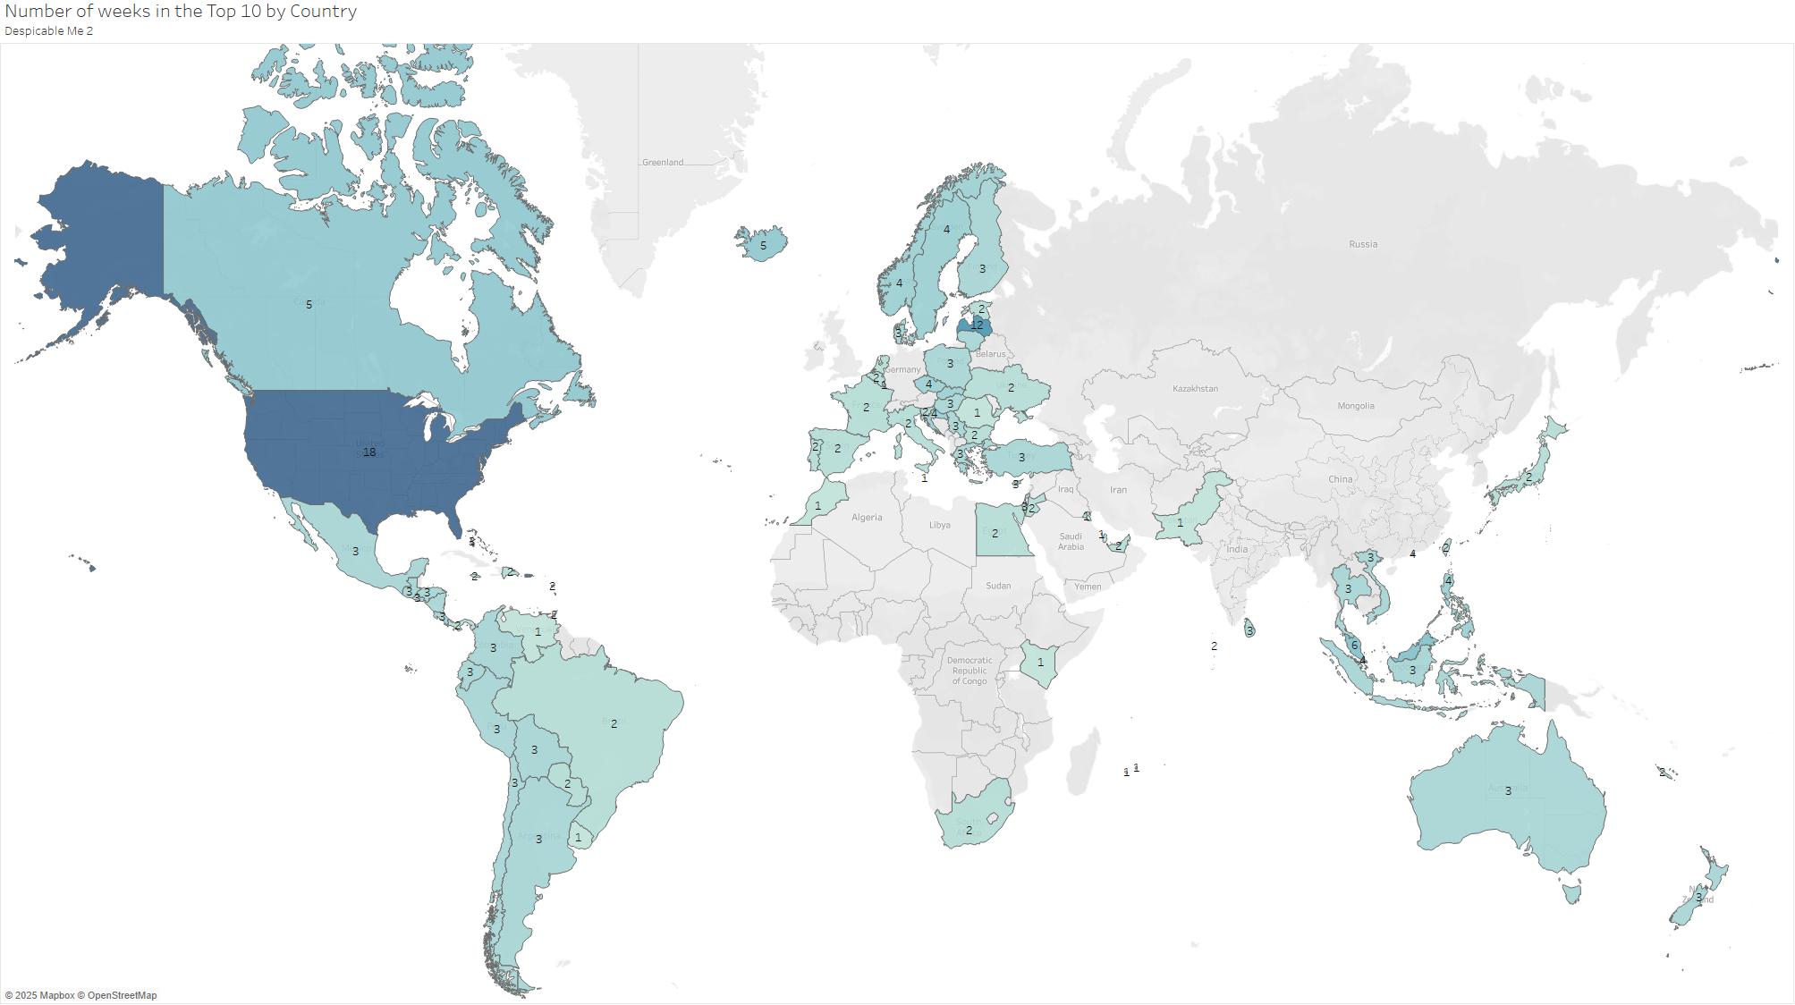
Despicable Me 2 weeks in top 10
Despicable Me 2 had a very strong showing in the US and a moderate showing in the rest of the world

Slide 7
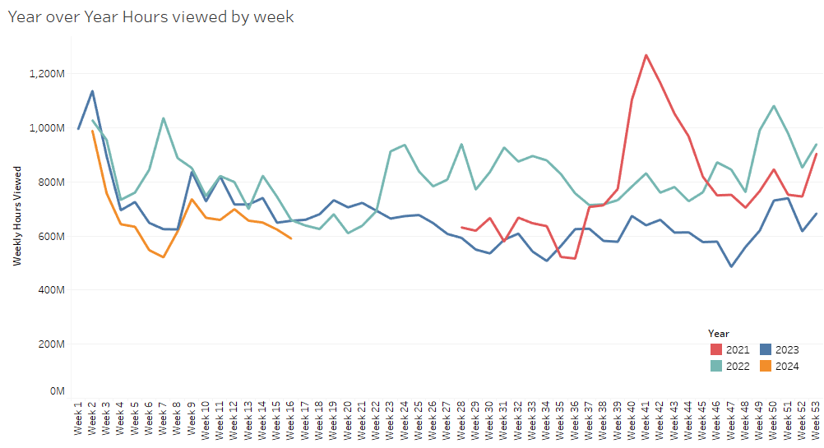
Hours watching by week of year
Work with the studios to release the movies for streaming between week 16 and 22 (Mid April – Early June) to avoid the summer block busters

